Slide 1


Constraint Satisfaction Problem
Ms. Swati Mali
swatimali@gmail.com
Assistant Professor
Department of Computer Engineering
K. J. Somaiya College of Engineering
Somaiya Vidyavihar University

Slide 2
Constraint satisfaction problems (CSPs)
Standard search problem: state is a "black box“ – any data structure that supports successor function, heuristic function, and goal test CSP:
state is defined by variables X_{i} with values from domain D_{i} goal test is a set of constraints specifying allowable combinations of values for subsets of variables
Simple example of a formal representation language
Allows useful general-purpose algorithms with more power than standard search algorithms

Slide 3
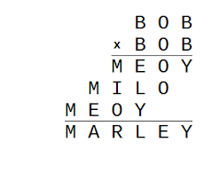
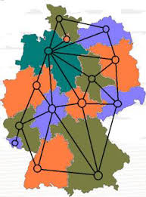
Sample Constraint Satisfaction Problems (CSP)
Crossword Puzzle
N-Queens on a Chess-Board
Time-Table Preparation
Flight Scheduling (Crew, Gate, Runway, etc)
Object / Scene Labelling
Cargo Packing
Map Colouring
Cryptic Puzzles
Scheduling the Hubble Telescope
Boolean Satisfiability (SAT)
CRYPTARITHMETIC PUZZLE
MAP COLOURING

Slide 4
Basic CSP Formulation
Variables
A Finite Set of Variables V_1, V_2, …., V_n
Domains
Each Variable has a Domain D_1, D_2, …., D_n from which it can take a value.
The Domains may be discrete or continuous domains
Satisfaction Constraints
A Finite Set of Satisfaction Constraints, C_1, C_2, …C_m
Constraints may be unary, binary or be among many variables of the domain
All Constraints have a Yes / No Answer for Satisfaction given values of variables
Optimization Criteria (Optional)
A Set of Optimization Functions O_1, O_2, ….O_p
These Optimization Functions are typically max or min type
Solution
To Find a Consistent Assignment of Domain Values to each Variable so that All Constraints are Satisfied and the Optimization Criteria (if any) are met.

Slide 5
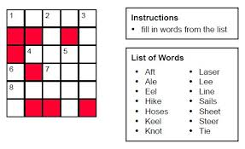
Example 1: Crossword Puzzle
VARIABLES
DOMAINS
SATISFACTION CONSTRAINTS
SOLUTION

Slide 6
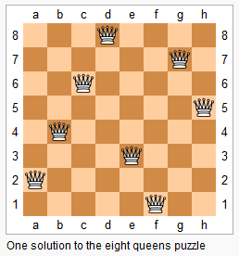
Example 2: N-Queens on a Chess Board
VARIABLES
DOMAINS
SATISFACTION CONSTRAINTS
SOLUTION

Slide 7
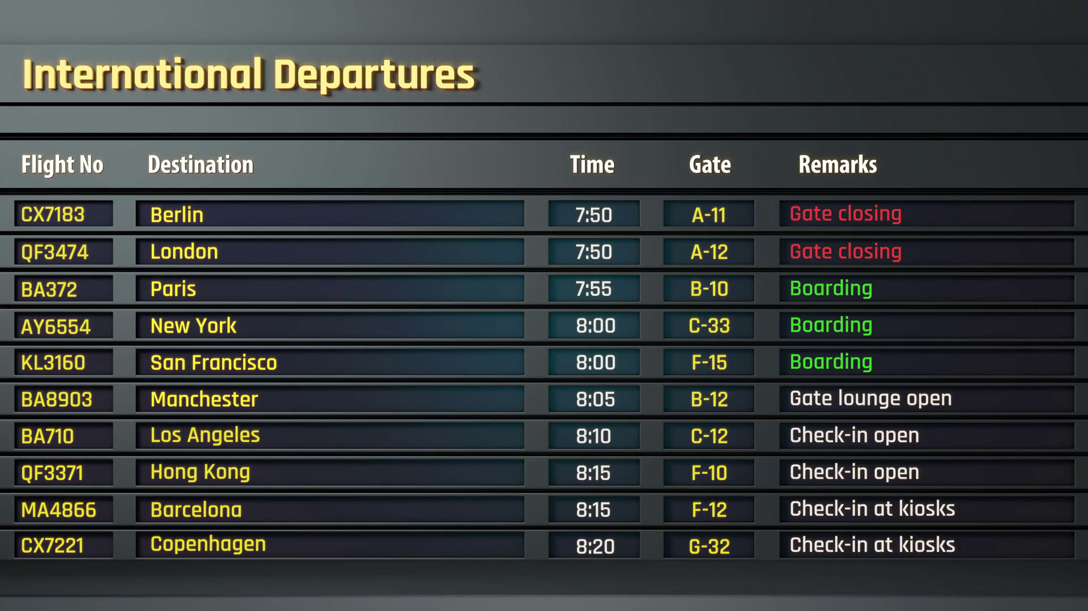
Example 3: Airport Flight Gate Scheduling
VARIABLES
DOMAINS
SATISFACTION CONSTRAINTS
OPTIMIZATION CRITERIA
SOLUTION

Slide 8
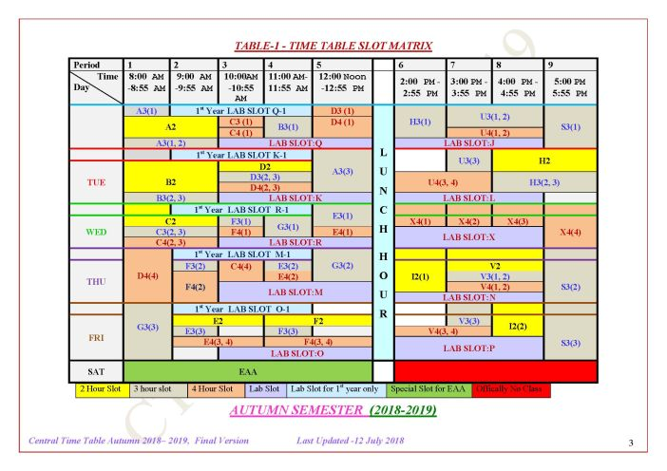
Example 4: Time Table Preparation
VARIABLES
DOMAINS
SATISFACTION CONSTRAINTS
OPTIMIZATION CRITERIA
SOLUTION

Slide 9
Varieties of constraints
Unary constraints involve a single variable,
e.g., SA ≠ green
Binary constraints involve pairs of variables,
e.g., SA ≠ WA
Higher-order constraints involve 3 or more variables,
e.g., cryptarithmetic column constraints

Slide 10
Solution Overview
The following Basic Steps are followed:
CSP Graph Creation:
Create a Node for Every Variable. All possible Domain Values are initially Assigned to the Variable
Draw edges between Nodes if there is a Binary Constraint. Otherwise Draw a hyper-edge between nodes with constraints involving more than two variables
Constraint Propagation:
Reduce the Valid Domains of Each Variable by Applying Node Consistency, Arc / Edge Consistency, K-Consistency, till no further reduction is possible. If a solution is found or the problem found to have no consistent solution, then terminate
Search for Solution:
Apply Search Algorithms to Find Solutions
Issues for Search: Backtracking Scheme, Ordering of Children, Forward Checking (Look-Ahead) using Dynamic Constraint Propagation
Solving by Converting to Satisfiability (SAT) problems

Slide 11
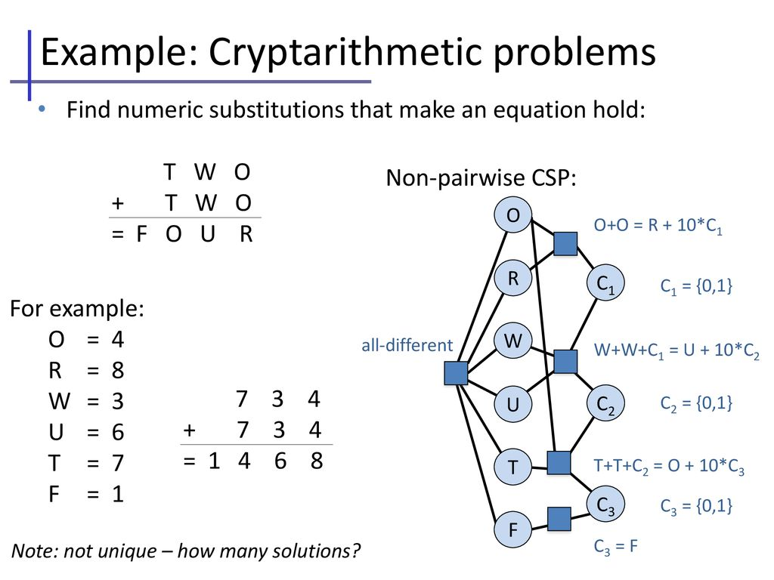

Slide 12
CSP with backtracking
As F=1, T+T+C2 >=10
For T=4 , T+T+C2 = 4+4+0/1 < 10
Thus, T must be > = 5
For T= 5 and C2=0, T+T+C2 = 5+5+0 = 10, making O= 0. But O + O = C1+R, conflict, hence backtrack. (if O + O was equal to O, O=0 could have been correct)
For T= 5 and C2=1, T+T+C2 = 5+5+1 = 11, making O= 1. But F=1. Two letters cant have same value, so backtrack
For T= 6 and C2=0, T+T+C2 = 6+6+0 = 12, hence F=1 and O = 2. if O+O = C1 +R, C1 will be zero. Continue with { F=1, O=2, R=4, C2=0 } till no conflict.
In case of conflict, backtrack.
If no conflict, add the letter and number assignment to constraint set and proceed further for remaining values for which the values are to be calculated yet.

Slide 13
CSP with backtracking
E.g. constraints- { F=1, T= 7, O=4, hence C2=0, as O=4, R=8, C1=0 as O+O is less than 10}
Find out values of W, U from remaining domain values = {0,2,3,5,6,9}
Make guesses, apply constraints till no conflict, in case of conflict- backtrack and try another assumption

Slide 14
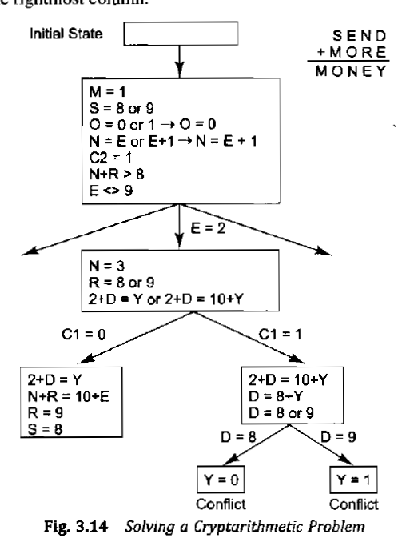
Example CSP with backtracking in case of conflict
Source: “Artificial Intelligence”, Elaine Rich and Kelvin Knight

Slide 15
Draw the CSP Graph for the Crossword
1
2
3
4
Word List:
astar, happy, hello, hoses, live, load, loom, peal, peel, save, talk, ant, oak, old

Slide 16
Draw CSP Graphs for the Following
Flight No | Dep Time
F1 | 7:00
F2 | 8:30
F3 | 7:45
F4 | 9:45
F5 | 10:00
F6 | 9:00
F7 | 11:00
CRYPTARITHMETIC
FLIGHT GATE SCHEDULING
MAP COLOURING

Slide 17
Flight Gate Scheduling
Flight No | Dep Time | G Start | G End
F1 | 7:00 | 6:15 | 7:15
F2 | 8:30 | 7:45 | 8:45
F3 | 7:45 | 7:00 | 8:00
F4 | 9:45 | 9:00 | 10:00
F5 | 10:00 | 9:15 | 10:15
F6 | 9:00 | 8:15 | 9:15
F7 | 11:00 | 10:15 | 11:15
F1
F2
F3
F4
F5
F6
These are special kinds of graphs called INTERVAL GRAPHS
F7

Slide 18
Constraint Propagation Schemes
Constraints
Unary Constraints or Node Constraints
Binary Constraints or Edges between CSP Nodes
Higher order or Hyper-Edges between CSP Nodes
Node Consistency
For every Variable V_i, remove all elements of D_i that do not satisfy the Unary Constraints for the Variable
First Step is to reduce the domains using Node Consistency
Arc Consistency
For every element x_ij of D_i, for every edge from V_i to V_j, remove x_ij if it has no consistent value(s) in other domains satisfying the Constraints
Continue to iterate using Arc Consistency till no further reduction happens.
K-Consistency or Path Consistency
For every element y_ij of D_i, choose a Path of length L with L variables, use a consistency checking method similar to above to reduce domains if possible

Slide 19
Methods of solving CSP
Sequential assignment approach
Backtracking sequential assignment

Slide 20
Sequential assignment approach
straightforward, dumb approach, then fixes the solution
States are defined by the values assigned so far
Initial state: the empty assignment, {}
Successor function: assign a value to an unassigned variable that does not conflict with current assignment ➔ fail if no feasible assignments. (not fixable!)
Goal test: the current assignment is complete
1) Every solution appears at depth n with n variables ➔ use depth-first search
2) b=(n -l)d at depth l, hence n!d^{n} leaves!

Slide 21
Backtracking sequential assignment
Two variable assignment decisions are commutative, i.e.,
[W =red then N =green] same as [N =green then W =red]
Can fix a single next variable to assign a value to at each node
This does not compromise completeness (ability to find the solution) ➔ b=d and there are d^{n} leaves
Depth-first search for CSPs with single-variable assignments is called backtracking search
Backtracking search is the basic uninformed algorithm for CSPs
Can solve n-queens for n 25

Slide 22
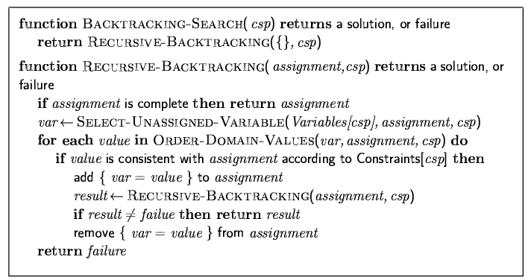
Backtracking search

Slide 23

Backtracking example

Slide 24
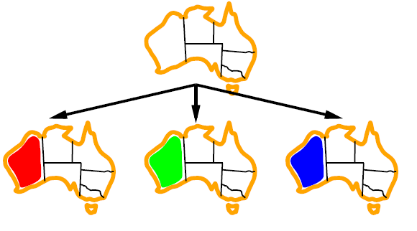
Backtracking example

Slide 25
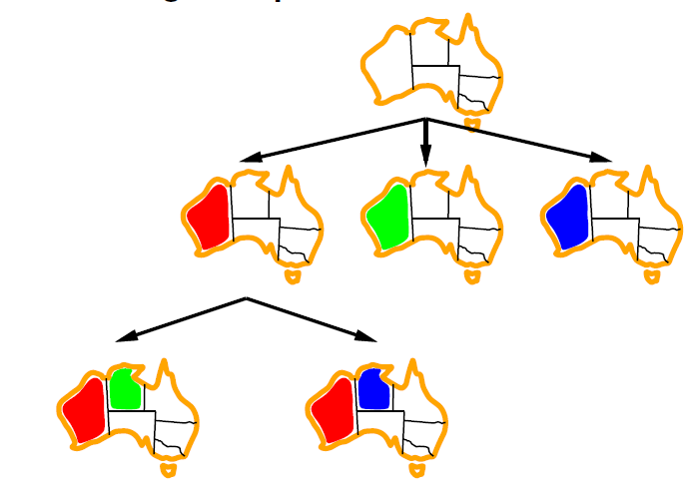
Backtracking example

Slide 26
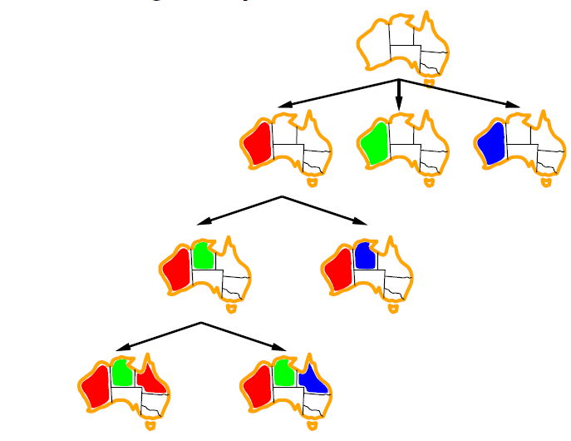
Backtracking example

Slide 27
Improving backtracking efficiency
Simple heuristics can give huge gains in speed:
Which variable should be assigned next?
In what order should its values be tried?
Can we detect inevitable failure early?
Can we take advantage of problem structure?

Slide 28
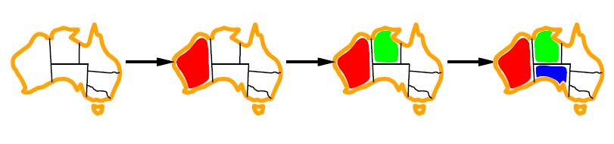
Heuristic method 1:Minimum remaining values
Minimum remaining values (MRV): choose the variable with the fewest legal values

Slide 29

Heuristic method 2:Degree heuristic
Tie-breaker among MRV variables
Degree heuristic: choose the variable with the most constraints on remaining variables

Slide 30
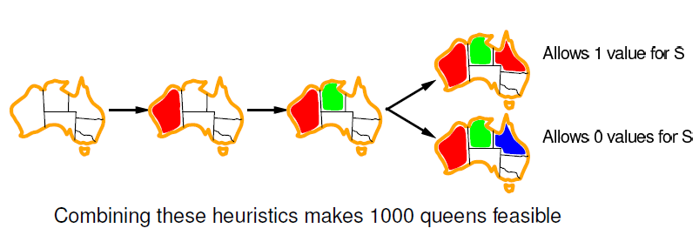
Heuristic method 3:Least constraining value
Given a variable, choose the least constraining value:
the one that rules out the fewest values in the remaining variables

Slide 31
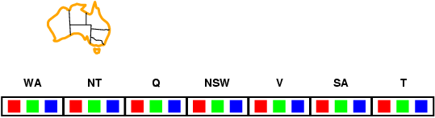
Forward checking
Idea:
Keep track of remaining legal values for unassigned variables
Terminate search when any variable has no legal values

Slide 32
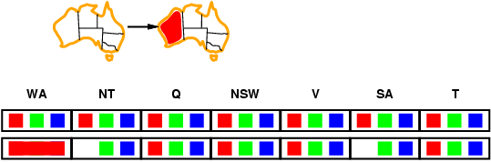
Forward checking
Idea:
Keep track of remaining legal values for unassigned variables
Terminate search when any variable has no legal values

Slide 33
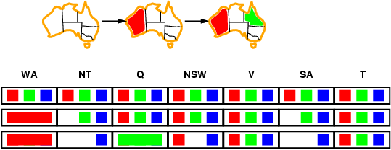
Forward checking
Idea:
Keep track of remaining legal values for unassigned variables
Terminate search when any variable has no legal values

Slide 34
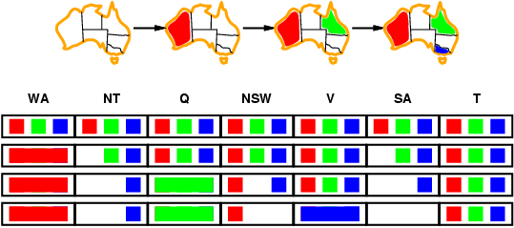
Forward checking
Idea:
Keep track of remaining legal values for unassigned variables
Terminate search when any variable has no legal values

Slide 35
Constraint propagation
Forward checking propagates information from assigned to unassigned variables, but doesn't provide early detection for all failures:
NT and SA cannot both be blue!
Constraint propagation repeatedly enforces constraints locally

Slide 36
Constraint propagation
After each decision (assigning a value to one variable) we can compute what are the remaining feasible values for all other variables.
Initially, every variable has the full domain Di. Constraint propagation reduces these domains, deleting entries that are inconsistent with the new decision.
These dependencies are recursive: Deleting a value from the domain of one variable might imply infeasibility of some value of another variable ! Constraint propagation. We update domains until they’re all consistent with the constraints.
This is Inference!!

Slide 37
Strategies for CSP Search Algorithms
Initial Constraint Propagation
Backtracking Search
Variable Ordering
Most Constrained Variable / Minimum Remaining Values
Most Constraining Variable
Value Ordering
Least Constraining Value leaving maximum flexibility
Dynamic Constraint Propagation Through Forward Checking
Preventing useless Search ahead
Dependency Directed Backtracking
SAT Formulations and Solvers
Optimization
Branch-and-Bound
SMT Solvers, Constraint Programming
Learning, Memoizing, etc
CSP Problems are NP-Hard in General

Slide 38
Summary
CSPs are a special kind of problem:
states defined by values of a fixed set of variables
goal test defined by constraints on variable values
Sequential assignment approach
Backtracking = depth-first search with one variable assigned per node
Variable ordering and value selection heuristics help significantly
Forward checking prevents assignments that guarantee later failure
Constraint propagation (e.g., arc consistency) does additional work to constrain values and detect inconsistencies
Iterative min-conflicts is usually effective in practice
Constraint propagation (e.g., arc consistency) does additional work to constrain values and detect inconsistencies
The CSP representation allows analysis of problem structure
Tree-structured CSPs can be solved in linear time
If after assigning some variables, the remaining structure is a tree → linear time feasibility check by tree CSP

Slide 39
Thank you

Slide 40
Question
?

